Slide 1
Data Backup Inventory Management System

Slide 2
Table Of Contents
Overview
Benefits
Modules :
User Panel
Admin Panel

Slide 3
Overview
File system backup can be defined as the collection of files and the file management structures on physical or logical storage.
Backups are initiated from the servers.
The User Panel helps the user to add the details of the backup tapes.
The Admin Panel . . .
We can have different types of backups of the systems i.e. daily backups, weekly backups, monthly backups and yearly backups.

Slide 4
Benefits
Higher Reliability – The biggest benefit of regular data backup is its great reliability. Backup can be automated and updated on a daily basis, weekly basis and monthly basis.
Greater Security – When you employ data backup, you store your data in a secure location, making it physically safe.
Ease of Recovery – Due to multiple levels of redundancy, if data is lost or deleted, most likely through individual user error or deletion, backups are available.

Slide 5
User Panel
The user have various privileges where he can perform different functions such as :
Check Available Backup Summary.
Check Send/Receive Backup Summary.
Check Daily/Yearly Backup Summary.
Add Backup.
Send Backup.

Slide 6
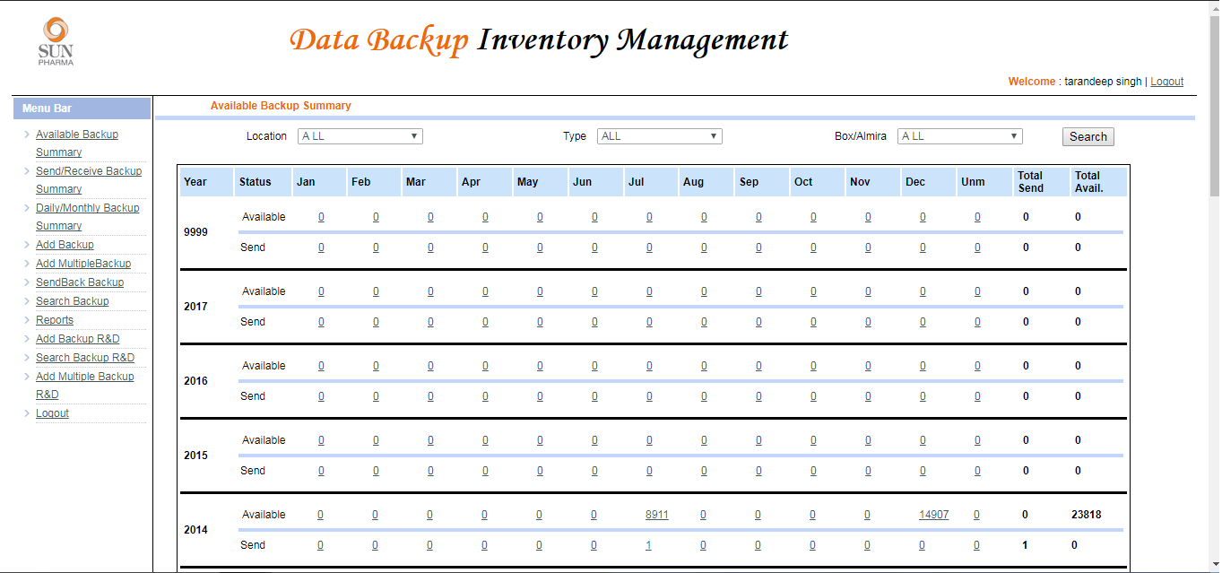
Available Backup Summary
The below picture shows us the summary of the available backups tapes in a location.

Slide 7
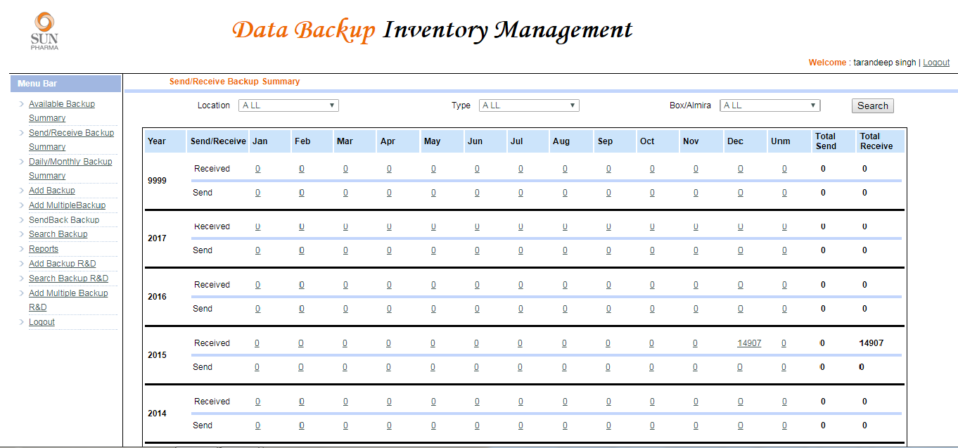
Send/Receive Backup Summary
The below picture shows the Tapes we have received yearly and the tapes we have sent back.

Slide 8
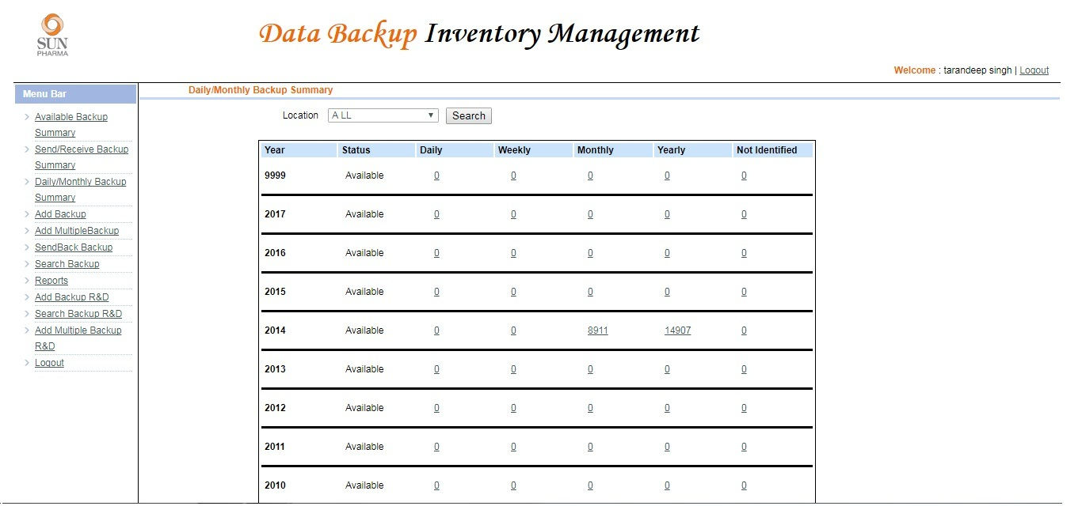
Daily/Monthly Backup Summary
The below picture shows the availability of backup tapes at a particular location, arranging them in daily, weekly, monthly and yearly.

Slide 9
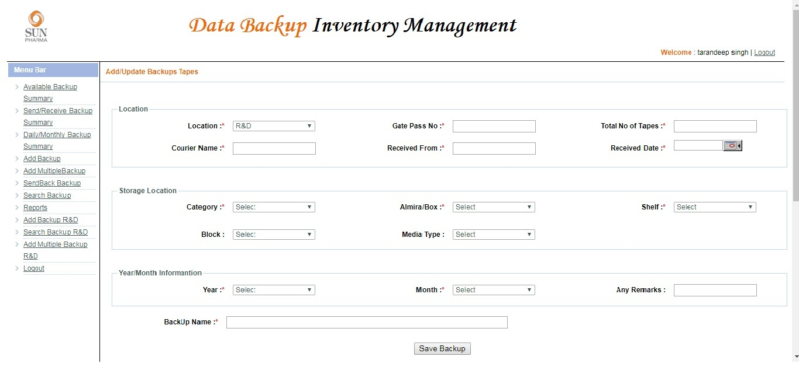
Add Backup
The add backup is used to add a record in the system. It has various fields which are filled by the user at the time of entering a new backup tape.

Slide 10
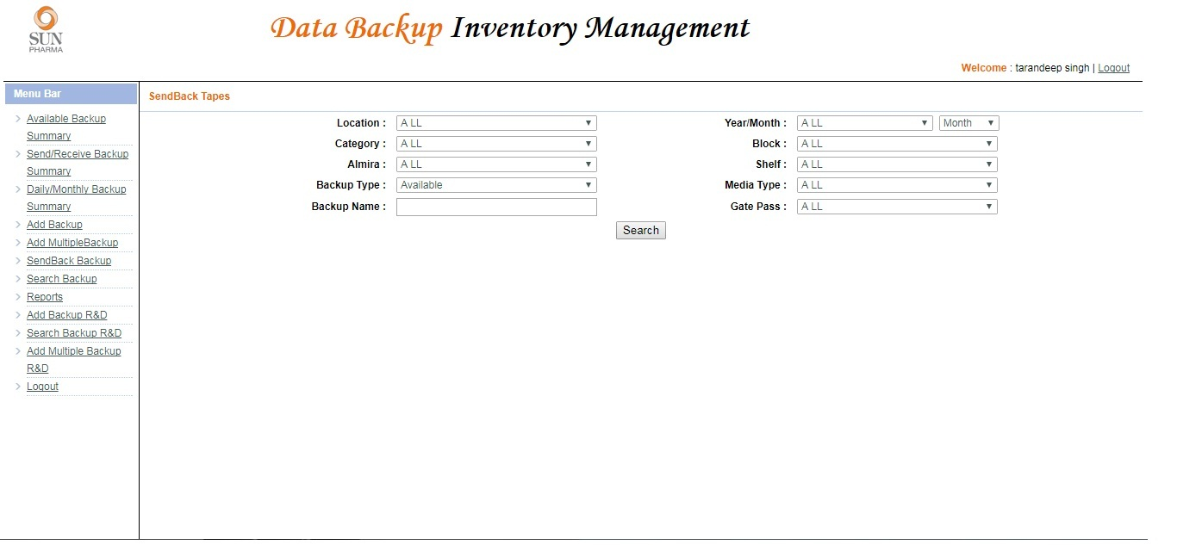
Send Backup

Slide 11
Admin Panel

